Slide 1

CCPS 506
Comparative Programming Languages
Fall 2019
Lecture 10: Ownership and Lifetime in Rust

Slide 2
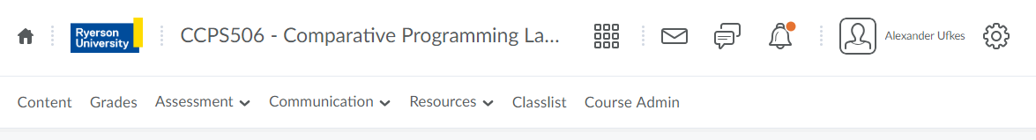
Course Administration
GETTING CLOSER! Two more weeks.
Final Exam is on December 7
90% Haskell and Rust
Same style as midterm
Don’t forget about the assignments!

Slide 3


Slide 4
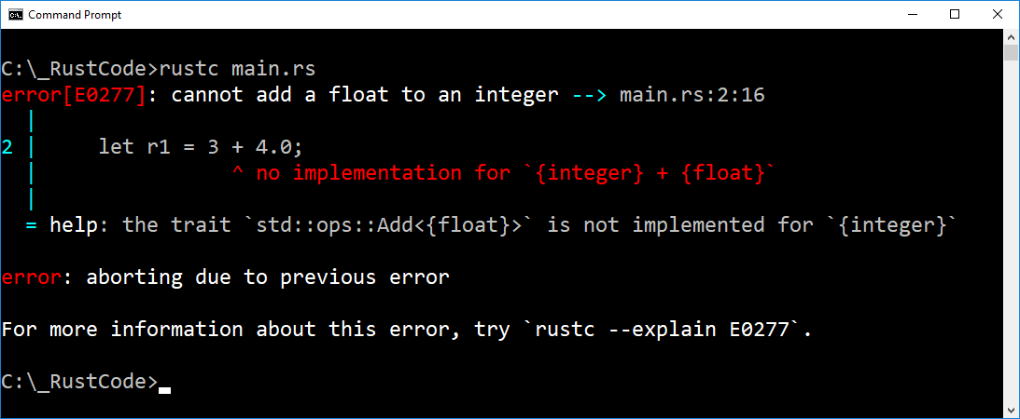
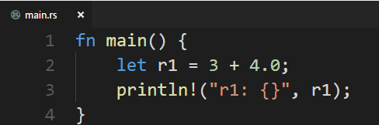
Rust: In Summary

Slide 5
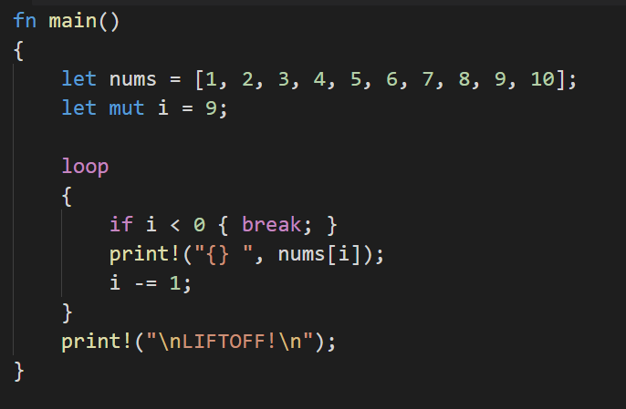
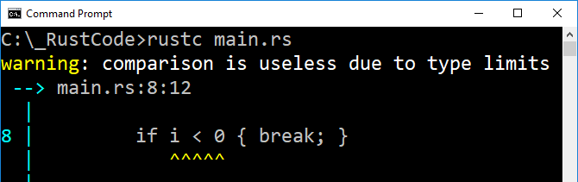
Rust: In Summary
Rust infers type, i32 should be default
Rust doesn’t allow signed integers to be used as array indexes!
It inferred the type as unsigned! Thus checking less than zero is pointless

Slide 6
Moving on….

Slide 7

Ownership

Slide 8
Ownership
Arguably Rust’s most unique feature
In C, the programmer is responsible for allocating and freeing memory. Memory leaks common!
In Java, garbage collector periodically looks for unused memory and frees it.
Rust takes a third approach: A system of ownership with rules checked at compile time.
Thus program is not slowed at run-time!

Slide 9
Reminder: Stack VS Heap
Stack:
Last in, first out
Push/pop stack frames is fast
Data has known, fixed size.
Heap:
Less organized
Slower to access, follow pointers
Data size can be unknown
If we dynamically allocate memory in C++, let’s say, the pointer goes on the stack, the memory itself is in the heap.
Heap memory is allocated by the OS at the request of the program.
Stack memory (some fixed amount) belongs to the program, no need to invoke the OS.

Slide 10
Ownership
Three rules:
Each value in Rust has a variable that’s called its owner.
There can only be one owner at a time.
When the owner goes out of scope, the value is dropped.

Slide 11
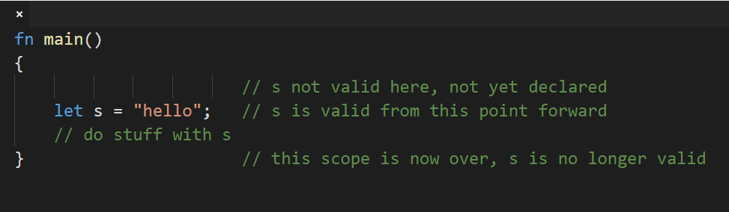
Scope in Rust
This is normal, nothing new.

Slide 12
Scope in Rust
Primitives stored on the stack behave as per usual.
How does Rust clean up data stored on the heap?
Let’s consider Strings – A complex type stored on the heap.

Slide 13
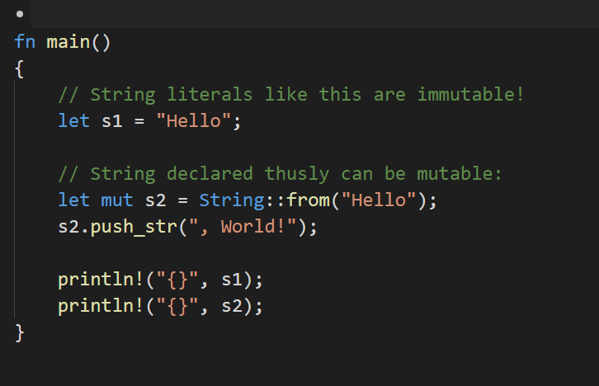
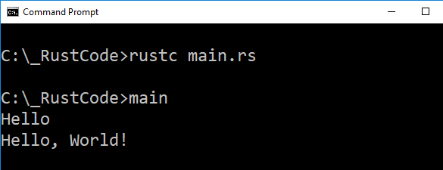
Strings
String literals are different from regular strings.
Their size is fixed, encoded directly into the executable.
Strings not defined as a literal might have unknown size
They are stored on the heap.

Slide 14
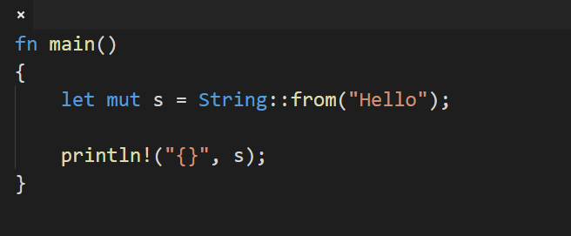
Heap Strings
Memory for string requested at run time.
Memory must be returned to the OS when we’re done with the string.
Calling String::from makes a memory request.
Once again, this is normal behavior. In Java we would say: String s = new String(“Hello”); to accomplish the same.
What happens when we no longer need that string?

Slide 15
What happens when we no longer need that string?
Without garbage collection, we have to identify when memory is no longer being used and free it explicitly.
Doing this correctly has historically been a difficult programming problem.
Too early, variables become invalid. Too late, waste memory. Do it twice by accident? Also an error.
We need to pair one allocate() to one free().
In Rust, memory is automatically returned when the variable that owns it leaves scope.

Slide 16
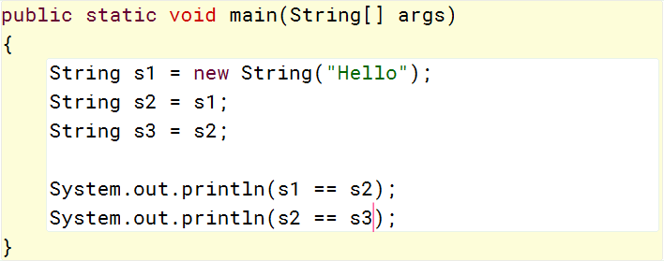
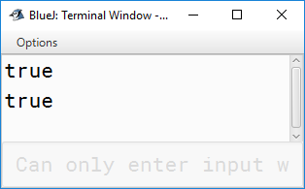
In Rust, memory is automatically returned when once the variable that owns it leaves scope.
What about having multiple references to a single object? Freeing after one leaves scope invalidates the others. In Java:
Three references, one object!

Slide 17
But Remember!
Ownership - Three Rules:
Each value in Rust has a variable that’s called its owner.
There can only be one owner at a time.
When the owner goes out of scope, the value is dropped.
There can only be one!

Slide 18
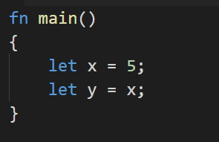
In Rust, memory is automatically returned when once the variable that owns it leaves scope.
When a variable goes out of scope, Rust calls a special function automatically called drop()
This function is called at the closing }
What happens we have multiple variables interacting with the same data?
With primitives, we get two separate variables stored in memory (stack)
x and y are separate – changing one does not affect the other
This is typical, and efficient

Slide 19
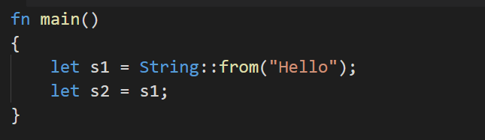
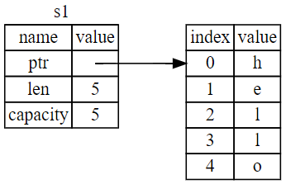
On the stack
On the heap

Slide 20
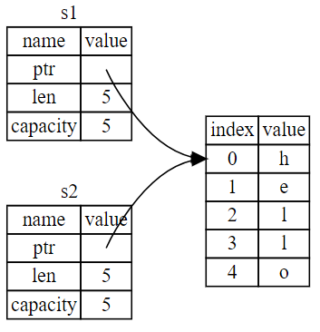
Stack data copied, heap data is not.
Copying heap data is more expensive.
This is typical in most imperative languages.
We can still potentially free data twice
We can still potentially invalidate other references

Slide 21
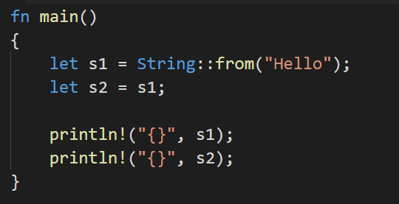
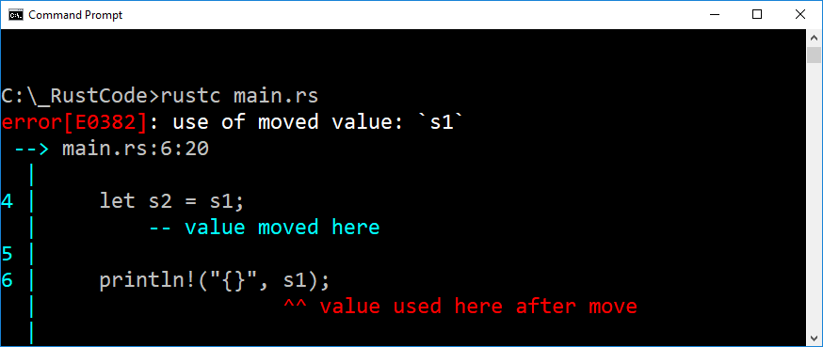
Each value in Rust has a variable that’s called its owner.
There can only be one owner at a time.
When the owner goes out of scope, the value is dropped.

Slide 22
Each value in Rust has a variable that’s called its owner.
There can only be one owner at a time.
When the owner goes out of scope, the value is dropped.
When we say let s2 = s1, s1 becomes invalid.
Thus, when it leaves scope, memory is not freed.
We can no longer use s1!

Slide 23
In Rust, we say s1 gets moved to s2

Slide 24
In Rust, we say s1 gets moved to s2
Different from a shallow copy, since the old reference is invalidated.
Only one reference can free the heap memory.

Slide 25
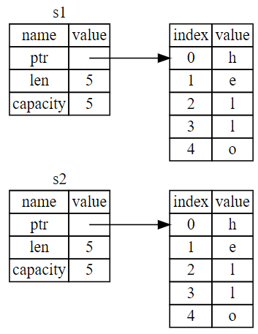
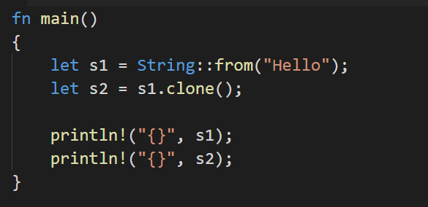
Deep Copy: clone()
Like most languages, Rust can deep copy:

Slide 26
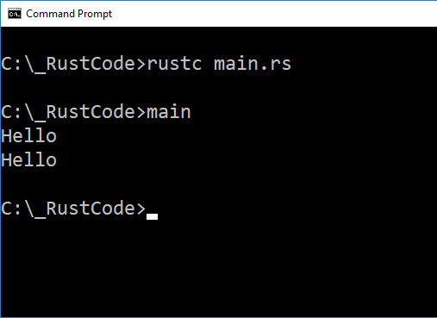
Deep Copy: clone()
Like most languages, Rust can deep copy:

Slide 27
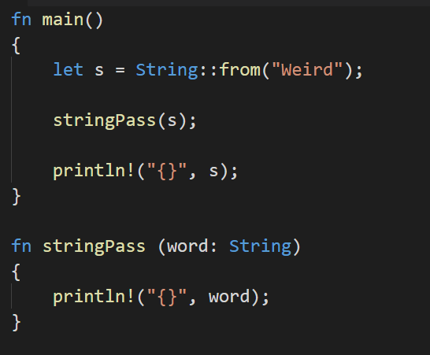
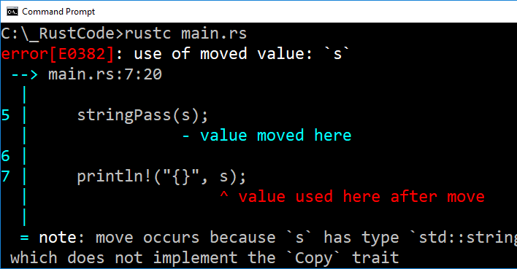
Ownership and Functions
Passing an argument moves or copies, just like assignment:

Slide 28
Ownership and Functions
Passing an argument moves or copies, just like assignment:
Ownership moved from s to word!
s is now invalid!
This is very different from any other language we’re used to.
This doesn’t happen with primitives because they will simply be copied.
We get a hint:

Slide 29
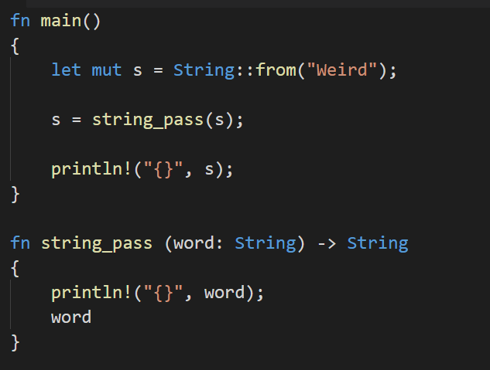


Returning Ownership

Slide 30
Returning Ownership
Ownership moved from s to word and back to s
s is invalid when we move to word
word is invalid when moved to s
Allowed because s is mutable.
When string_pass reaches }, word has already been moved to s
Thus word is invalid and the string on the heap isn’t freed.

Slide 31
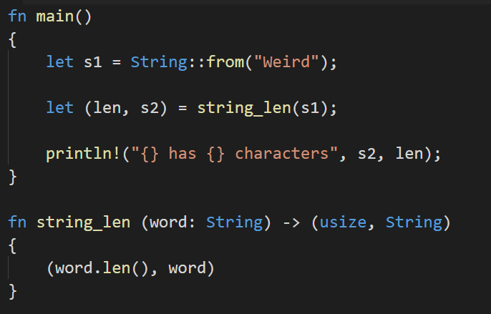
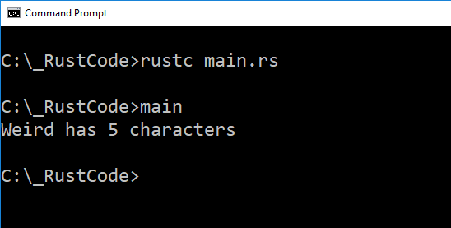
Returning Ownership
Limiting. Forced to use return value for ownership.
s1 moves to word, word moves to s2
Return a tuple consisting of the length of word, and word itself.
len() function returns length of array.

Slide 32
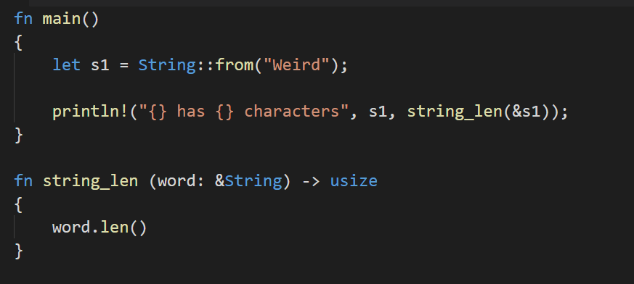
Ownership: Moving VS Borrowing
Instead of returning a tuple, pass a reference:
This looks similar to C++
word is now a reference to s1
What about ownership?
What’s happening in memory?

Slide 33
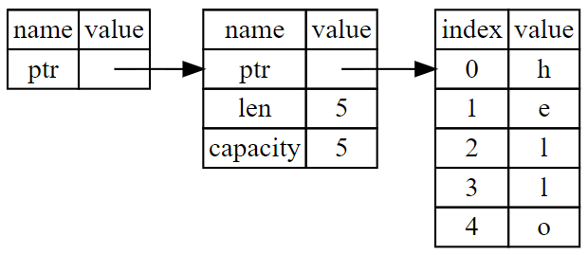
Ownership: Moving VS Borrowing
word
s1
word is a reference to s1, it does NOT point to the string in the heap.
word has no ownership over s1.
We call this borrowing.

Slide 34
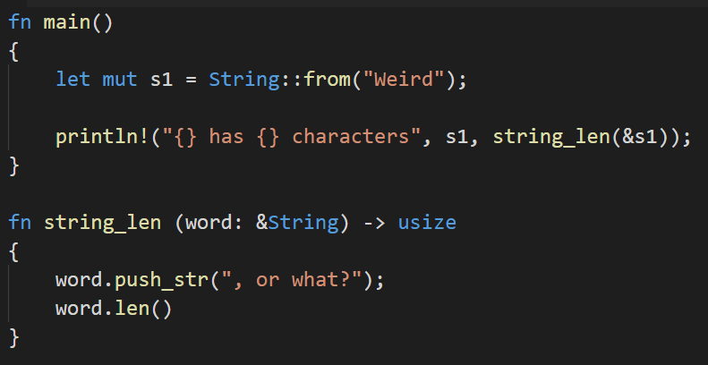
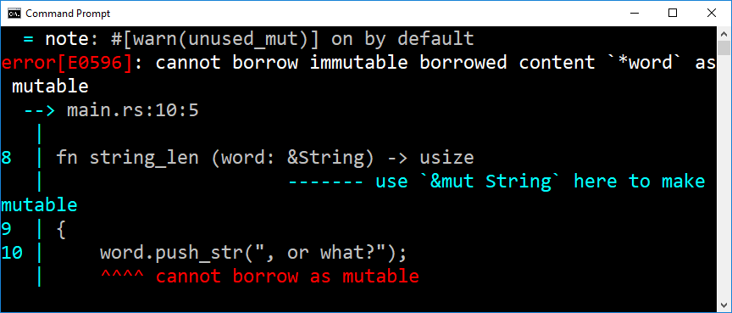
Ownership: Moving VS Borrowing
Unlike C++, we can’t modify something we’re borrowing:
?

Slide 35
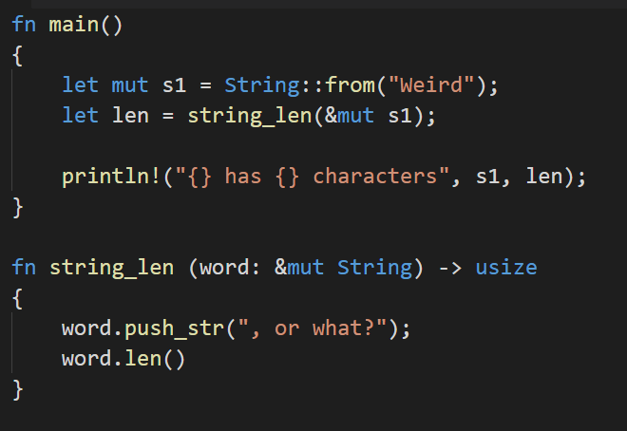
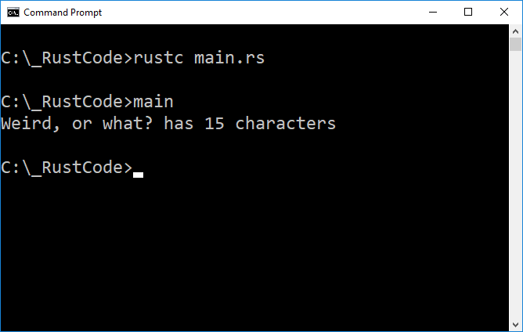

word is a mutable reference, borrowed from s1

Slide 36
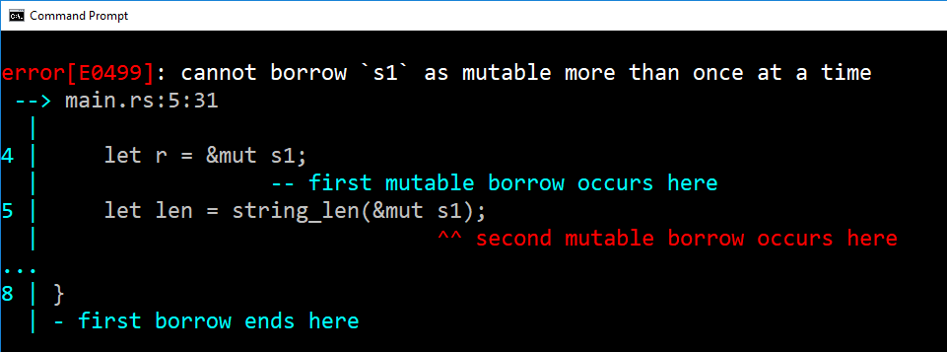
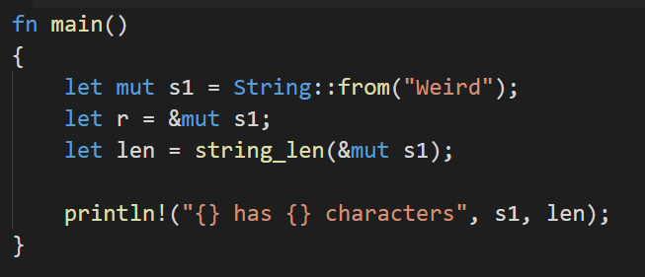
Borrowing Rules
Can only have one mutable borrow at a time:
When the first mutable borrow goes out of scope, we can borrow again

Slide 37
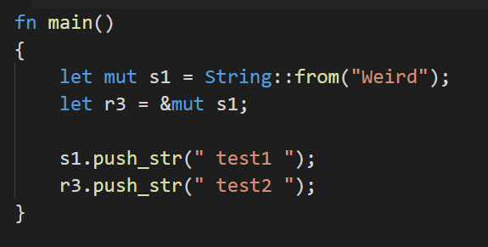
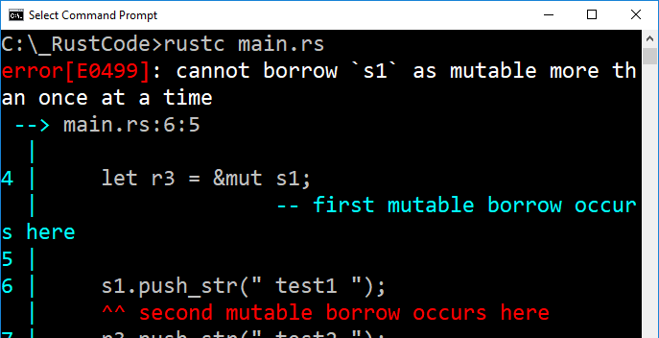
Borrowing Rules
Can only have one mutable borrow at a time:
push_str must make mutable borrow of s1
Not allowed!

Slide 38
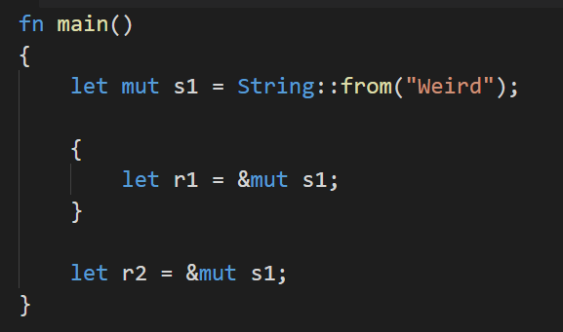
When the first mutable borrow goes out of scope, we can borrow again
Scope of r1
Scope of r2

Slide 39
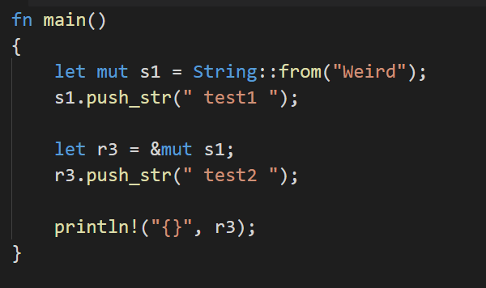

When the first mutable borrow goes out of scope, we can borrow again
Here, r3 is already a reference. We’re not borrowing again.

Slide 40
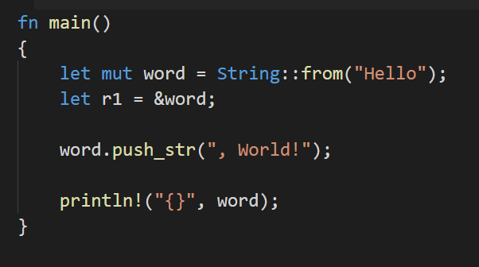
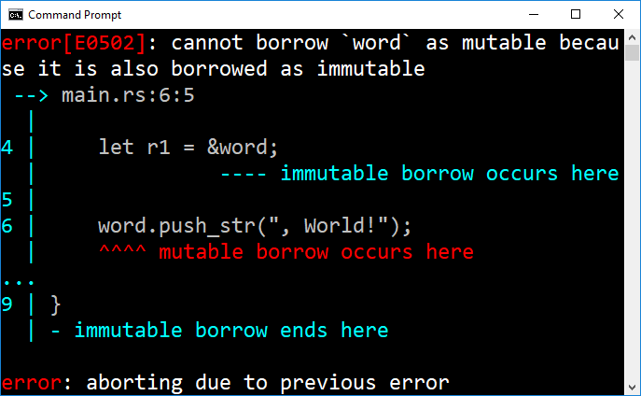
Borrowing Rules
Immutable borrow prevents mutable borrow:

Slide 41
Borrowing Rules: In Short
In any given scope, only ONE of the following can be true:
We can have a single mutable borrow
We can have any number of immutable borrows
These restrictions keep mutation under control

Slide 42

Slices

Slide 43
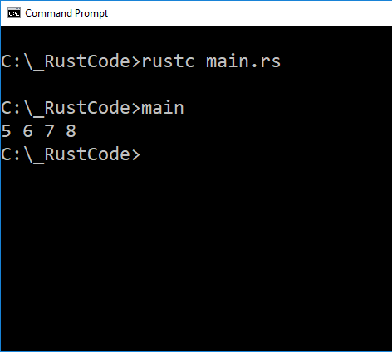
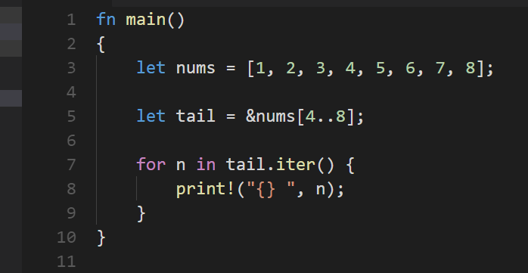
Slices
Reference to a subset of an array
We’ve seen this notation before!
Remember that the second index is not included

Slide 44
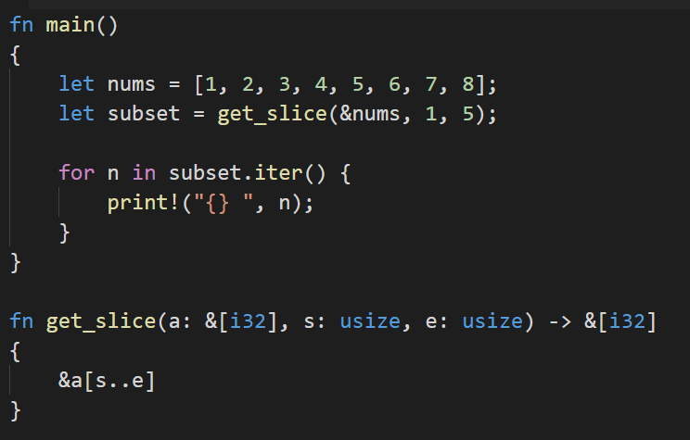
Slices, Arguments, Functions
Reminder: indexes must be usize
Pass in reference to array
Return slice – reference to subset of array
Array only exists once in memory
subset and nums point to different parts of the same memory.

Slide 45
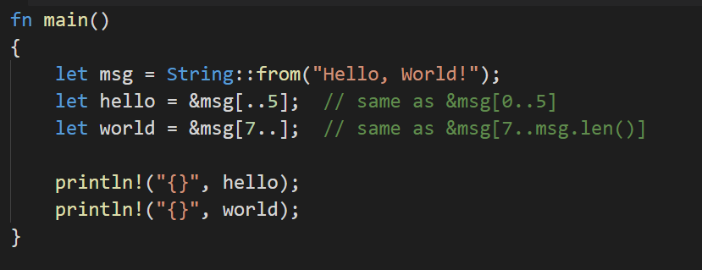
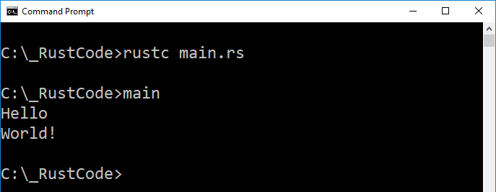
String Slices
… are a little bit different.
Normal so far

Slide 46
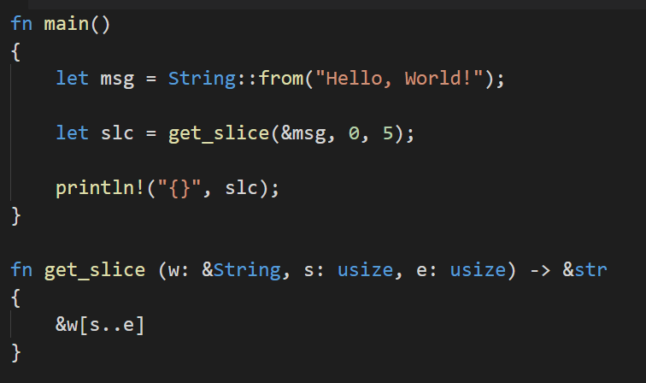
String Slice Type
&str is a reference to a string slice
&String is a reference to a String
String VS string slice: different types
Other than that, the function works the same as with numeric arrays.
A string slice is effectively a read-only view of a String.

Slide 47
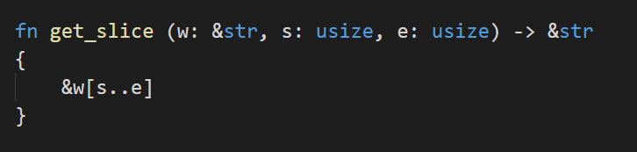
String Slice Type
Better to do this:
Works for both Strings and string slices

Slide 48
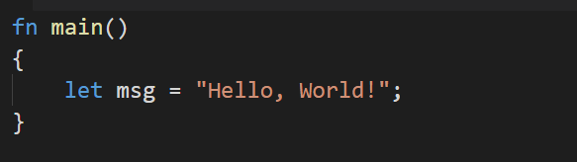
String Literals
String literals are different from regular strings.
Their size is fixed, encoded directly into the executable.
They are immutable.
Recall:
In fact, string literals are slices:
The type of msg is &str
It’s a slice pointing to a specific point of the binary file.
This is why string literals are immutable!

Slide 49

Rust Features
Memory Safety:
Rust is designed to be memory safe
Null or dangling pointers are not permitted.

Slide 50
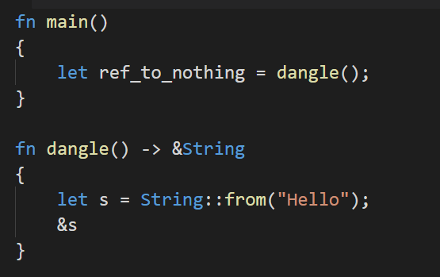
Dangling References
Rust prevents them:
dangle()
Create String s
Return a reference to it
s goes out of scope when dangle function ends.
What happens to the reference that was returned?

Slide 51
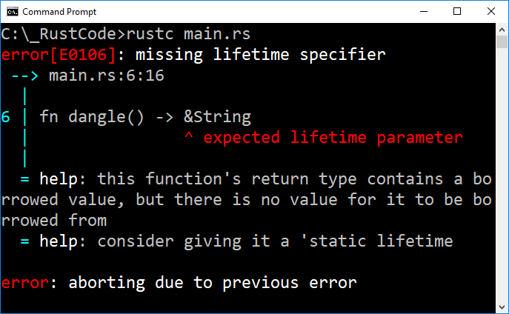
Dangling References
Rust prevents them:
Lifetime?

Slide 52

Lifetime

Slide 53
Lifetime is a very distinct feature of Rust:
Every reference in Rust has lifetime
The lifetime of a reference is the scope for which that reference is valid.
Lifetimes are typically implicit and inferred, but can be defined explicitly
Just like variable types!

Slide 54
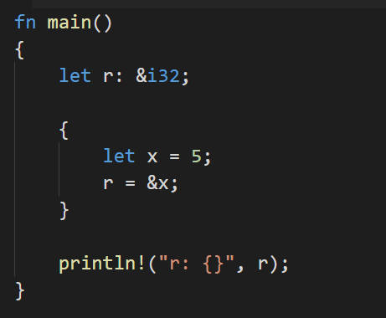

Example
r borrows x
x goes out of scope while r is still borrowing it!

Slide 55
The Borrow Checker
The Rust compiler has a “Borrow Checker” that compares scope to determine if borrows are valid
If one variable borrows another, the variable being borrowed must have a lifetime at least as long as the variable doing the borrowing.
What happens if the borrow checker gets confused?

Slide 56

Generic Lifetimes
Consider:
Simple program:
Function accepts two string slices, returns the slice that is longer.
Recall that slices are just references
There’s no ownership changing here
No moves

Slide 57

Generic Lifetimes
Consider:

Slide 58
Generic Lifetimes
The Borrow Checker can’t determine lifetime of the return value, because it’s not clear which input argument the return value will borrow from.
More generally: The borrow checker follows certain patterns when determining lifetime. If none of its patterns apply, we get a lifetime error.

Slide 59
Generic Lifetimes
We as programmers know that this function is perfectly safe.
x, y refer to string literals which live the entire duration of the program.
HOWEVER
What’s obvious to us is not necessarily obvious to the compiler.
Thus, we get compile errors.

Slide 60


Generic Lifetimes
It even happens when the return reference is fixed:

Slide 61


Lifetime Annotation Syntax
When the borrow checker is confused (for whatever reason), we have to be specific:
Specify generic lifetime
Similar to generic type: <T>
<‘a> specifies a generic lifetime, a
&’a says this reference has lifetime a

Slide 62
Generic Lifetimes
What does mean precisely?
The function accepts two arguments
Both live at least as long as lifetime a
Also, the string slice returned will live at least as long as lifetime a
We don’t know what a is, just that both arguments and return value have the same lifetime.

Slide 63
Generic Lifetimes
However!
We’re NOT actually changing any lifetimes!
We’re just explicitly indicating them to help the confused Borrow Checker.
The borrow checker will reject any values that don’t adhere to these constraints.
So how can we break this?

Slide 64

Consider
Lifetime of s1 is different from s2 and s3.
Lifetime a becomes the scope in which x and y are both valid. I.e., when s1 and s2 are valid
When we last use s3, s1 and s2 are still valid.
Thus, the borrow checker accepts this code.
s3 references something that is valid until after the last time s3 is used.

Slide 65


Now This:
Here, lifetime a excludes a reference made by s3
s3 references something the might be out of scope (s2 will be, s1 won’t be)
When we last use s3, s2 is no longer valid.
Although in this case it doesn’t matter, because we’ve declared both s1 and s2 as string slices.
Slices aren’t on the heap, and thus references to them will always be valid.
Oops. Let’s try again with Strings instead…

Slide 66



Slide 67


Lifetime Considerations
Depends what the function is doing
If we’re simply returning the first argument, we need not include y in our lifetime a
However, we can’t exclude it entirely

Slide 68

However, we can’t exclude it entirely

Slide 69


Lifetime Considerations
In general, we need some sort of lifetime indication any time we’re passing in more than one reference, and returning a reference.
This is fine, albeit pointless
As is this

Slide 70
Lifetime Considerations
If the relationship between references coming in and going out of a function isn’t obvious, the borrow checker complains.
Bearing in mind that what constitutes “obvious” to us is not necessarily obvious to the compiler or borrow checker.

Slide 71
What’s Obvious?
Originally, every reference required a lifetime specifier.
The Rust developers noticed some cases of reference passing were always exactly the same, and thus added them as patterns for the compiler to recognize without requiring explicit lifetime annotations.

Slide 72
What’s Obvious?
The compiler first checks its list of known patterns
If none are found, we get a compile error such as we’ve been seeing
What are these patterns?

Slide 73

Lifetime Inference Rules
The compiler first assigns a different lifetime to each reference input parameter.
Is seen as:

Slide 74

Lifetime Inference Rules
The compiler first assigns a different lifetime to each reference input parameter.
If there is one input reference parameter, it is assigned the same lifetime as any output references.
Is seen as:

Slide 75
Lifetime Inference Rules
The compiler first assigns a different lifetime to each reference input parameter.
If there is one input reference parameter, it is assigned the same lifetime as any output references.
If there are multiple input references, but one of them is &self, then the output references have the same lifetime as &self.
If, after applying these rules, there are still references without a lifetime specifier, we get a compile error.

Slide 76
If, after applying these rules, there are still references without a lifetime specifier, we get a compile error.
We don’t get errors here, because applying rules 1 and 2 results in all references having annotated lifetimes

Slide 77

We get an error here, because even after applying all three rules, we still don’t have a lifetime annotation for the output:
The compiler first assigns a different lifetime to each reference input parameter.
If there is one input reference parameter, it is assigned the same lifetime as any output references.
If there are multiple input references, but one of them is &self, then the output references have the same lifetime as &self.
11
11
Rule 1 applies, Rules 2 and 3 do not

Slide 78

We get an error here, because even after applying all three rules, we still don’t have a lifetime annotation for the output:
No lifetime annotation after applying rules.
Compile error.

Slide 79

Static Lifetime
A special lifetime that is simply the duration of the program.
String literals have a static lifetime.
Makes sense, they’re not on the heap but embedded in the executable

Slide 80
Static Lifetime
You might get error messages suggesting you use static lifetime.
Be careful doing so. Does your reference really need to live for the duration of the program? Probably not.
It’s a lazy solution, much like adding dozens of global variables to avoid using pointers or references.

Slide 81
Fantastic Rust Reference:
https://doc.rust-lang.org/book/second-edition/

